Slide 1
Global CyberBridges: A Model Global Collaboration Infrastructure for E-Science Between the United States and International Partners
Calit2 at UCSD Collaborative Workshop w/ GreenLight Project
Date: July 1, 2009

Slide 2
Presentation Agenda
GCB Program Overview
U.S. & Global Research & Education Networks Program Support
AMPATH International Exchange Point in Miami
General Applications
GCB Research Projects & Publications
Conclusion

Slide 3
Who’s Who?
Investigators
Heidi Alvarez, PI, Director of the Center for Internet Augmented Research and Assessment (CIARA) at FIU
Tom DeFanti, Co-PI (Calit2 at UCSD)
Julio Ibarra, Co-PI, Executive Director of CIARA
Kuldeep Kumar, Co-PI, Professor
S. Masoud Sadjadi, Co-PI, Assistant Professor of SCIS

Slide 4
External Assessment Committee
- Paul Avery, Professor of Physics, University of Florida
Hugh Gladwin, Director of the Institute for Public Opinion Research
Thomas Greene, Senior Research Fellow / Director of the Computer Science & Artificial Intelligence Laboratory (CSAIL) at MIT
Jane Klobus, Professor and Senior Research Fellow, Dondena Centre for Social Research, Bocconi University, Milan, Italy & Professorial Fellow, Graduate School of Management, University of Western Australia

Slide 5
What is Global CyberBridges?
Cyberinfrastructure Training, Education, Advancement, and Mentoring for Our 21st Century Workforce (CI-TEAM)
National Science Foundation Program Solicitation
http://www.nsf.gov/publications/pub_summ.jsp?ods_key=nsf06548&org=NSF
Three year award (Oct. 2006 - Dec. 2009) for $765,000 total to CIARA at FIU
The program expands on CyberBridges, which was initiated in 2005 to help FIU scientists and engineers advance their research through cyberinfrastructure (CI).

Slide 6
Global CyberBridges Benefits
Brings together graduate students & faculty from various disciplines
Offers greater understanding of R&E CI
Increases opportunity for cross-disciplinary R&E
Increases scientists’ rate of discovery
Creates a CI empowered workforce.
Research fellowship stipend of $5,000 total for Spring / Summer 2009
May be combined with other tuition waivers & stipends
May be split between 2 fellows working on a research project together

Slide 7
Activities Are on a Yearly Cycle; For Example
1st Semester: Feb. to May 2009
Participating in initial interviews
Attending the GCB training
Learning about HPC and how to use it
Team building
Brainstorming and planning for the project with your team
Weekly group meeting (EVO or Skype for video conferencing)
Preparing a lecture and delivering it in the class
2nd Semester: June to Nov. 2009
Working on the project
Running experiments
Attending weekly meetings
Writing a technical paper targeted to a conference
Participating in final interviews

Slide 8
Outcomes & Evaluation
A new generation of scientists & engineers
Capable of fully integrating CI into the whole educational, professional, and creative process of their diverse disciplines.
Short Term Outcome Measurement:
Proposed and realized timeline for implementing the activities
Longer term Outcome Measurements:
Publication, presentation, and other metrics determined by the outside experts to be appropriate for the research activities

Slide 9
Fellowship Requirements Year 3 of 3
Course begins in Spring 2009 at end of February
Advanced Networking
Grids/Distributed Computing
Virtual Teams
Scalable Adaptive Graphics Environment (SAGE)
Course Continues through Summer 2009
Students and faculty will collaborate on a paper based on the research
Research results to be published & presented at a conference
Student’s travel expenses covered
Attendance at major conference in Fall 09 or Spring 10
Usually SuperComputing to present research findings

Slide 10
Fellowship Qualifications
Candidates must be on a research path that can be augmented by CI
Open to graduate students in science or engineering
PhD students preferred
Some programming background desired
C or C++ preferred, JAVA or Fortran OK

Slide 11
How to Apply
Submit a 1 page proposal
Describe a problem in your area of research
Provide a hypothesis on how the use of CI would benefit the research process.
Attach a one-page bio/CV
Show any networking, grid, or related CI experience
Submit all documents to info@cyberbridges.net
Faculty advisor must indicate support via letter of support
Due by November 14th, 2008
Selection announced by December 1st, 2008

Slide 12
Projects in 2006
Unsupervised Pattern Discovery in Protein Structures
Computer Science & Bioinformatics
Modeling Biological Tissue Scaffolds in Three Dimensions
Biomedical Engineering
Interplay between Random Matrix Theory and Quantum Field
Physics
Functionalities of a specific enzyme for certain reactions
Chemistry/Biochemistry

Slide 13
Projects in 2007
Grid Enablement of Hurricane Simulation Application
Earth Sciences
On Demand Weather Forecast Visualization via Efficient Resource Utilization in Grid Computing
Visualization
Computational Modeling & Simulation of Biodegradable Starch based polymer composites
Computational Chemistry
Collaboration Platform
e-Science and e-Society

Slide 14
Projects in 2008
The Development of Collaborative Platform Based on SAGE
Computer Science - Visualization
Innovative Grid-Enable Multiple-Scale Hurricane Modeling System
Earth Sciences
Finding Repeat Structures in Genomic Sequences
Computer Science – Bioinformatics
A Distributed Multimedia Data Management over the Grid
Computer Science – Multimedia

Slide 15
Publications
Selim Kalayci, Onyeka Ezenwoye, Balaji Viswanathan, Gargi Dasgupta, S. Masoud Sadjadi, and Liana Fong. Design and implementation of a fault tolerant job flow manager using job flow patterns and recovery policies. In Proceedings of the 6th International Conference on Service Oriented Computing ( ICSOC'08), Sydney, Australia, December 2008. Accepted for publication (acceptance rate 20.4%).
Hector A. Duran Limon, S. Masoud Sadjadi, et al. Grid enablement and resource usage prediction of weather research and forecasting. In Proceedings of the Collaborative and Grid Computing Technologies Workshop, Cancun, Mexico, April 2008.
Gargi Dasgupta1, Onyeka Ezenwoye, Liana Fong, Selim Kalayci, S. Masoud Sadjadi, and Balaji Viswanathan. Design of a fault-tolerant job-flow manager for grid environments using standard technologies, job-flow patterns, and a transparent proxy. In Proceedings of the 20th International Conference on Software Engineering and Knowledge Engineering (SEKE'2008), San Francisco Bay, USA, July 2008.
Chi Zhang, Bin Liu, Xun Su, Heidi Alvarez, and Julio Ibarra. Integrating heterogeneous network monitoring data. In Telecommunication Systems, February, 2008, DOI 10.1007/s11235-008-9073-5.
Khalid Saleem, S. Masoud Sadjadi, and Shu-Ching Chen. Towards a self-configurable weather research and forecasting system. In Proceedings of the 5th IEEE International Conference on Autonomic Computing (ICAC-2008), Chicago, IL, June 2008. (38% acceptance rate).
Yanbin Liu, S. Masoud Sadjadi, Liana Fong, Ivan Rodero, David Villegas, Selim Kalayci, Norman Bobroff, and Juan Carlos Martinez. Enabling autonomic meta-scheduling in grid environments. In Proceedings of the 5th IEEE International Conference on Autonomic Computing (ICAC-2008), Chicago, IL, June 2008. (38% acceptance rate).
Gargi Dasgupta, Onyeka Ezenwoye, Liana Fong, Selim Kalayci, S. Masoud Sadjadi, and Balaji Viswanathan. Runtime fault-handling for job-flow management in grid environments. In Proceedings of the 5th IEEE International Conference on Autonomic Computing (ICAC-2008), Chicago, IL, June 2008. (38% acceptance rate).
Norman Bobroff, Liana Fong, Selim Kalayci, Yanbin Liu, Juan Carlos Martinez, Ivan Rodero, S. Masoud Sadjadi, and David Villegas. Enabling interoperability among meta-schedulers. In Proceedings of 8th IEEE International Symposium on Cluster Computing and the Grid (CCGrid-2008), Lyon, France, 2008.

Slide 16
Publications
S. Masoud Sadjadi, Shu Shimizu, Javier Figueroa, Raju Rangaswami, Javier Delgado, Hector Duran, and Xabriel Collazo. A modeling approach for estimating execution time of long-running scientific applications. In Proceedings of the 22nd IEEE International Parallel & Distributed Processing Symposium (IPDPS-2008), the Fifth High-Performance Grid Computing Workshop (HPGC-2008), Miami, Florida, April 2008.
S. Masoud Sadjadi, Liana Fong, Rosa M. Badia, Javier Figueroa, Javier Delgado, Xabriel J. Collazo-Mojica, Khalid Saleem, Raju Rangaswami, Shu Shimizu, Hector A. Duran Limon, Pat Welsh, Sandeep Pattnaik, Anthony Praino, David Villegas, Selim Kalayci, Gargi Dasgupta, Onyeka Ezenwoye, Juan Carlos Martinez, Ivan Rodero, Shuyi Chen, Javier MuÃ±oz, Diego Lopez, Julita Corbalan, Hugh Willoughby, Michael McFail, Christine Lisetti, and Malek Adjouadi. Transparent grid enablement of weather research and forecasting. In Proceedings of the Mardi Gras Conference 2008 - Workshop on Grid-Enabling Applications, Baton Rouge, Louisiana, USA, January 2008.
S. Masoud Sadjadi, Selim Kalayci, and Yi Deng. A self-configuring communication virtual machine. In Proceedings of the 2008 IEEE International Conference on Networking, Sensing and Control (ICNSC-08), Sanya, China, April 2008. (accepted for publication.).
Xing Hang, David Villegas Castillo, S. Masoud Sadjadi, and Heidi Alvarez. Formative assessment of the effectiveness of collaboration in gcb. In Proceedings of the International Conference on Information Society (i-Society 2007), Merrillville, Indiana, USA, October 2007.
Heidi L. Alvarez, David Chatfield, Donald A. Cox, Eric Crumpler, Cassian Dâ€™Cunha, Ronald Gutierrez, Julio Ibarra, Eric Johnson, Kuldeep Kumar, Tom Milledge, Giri Narasimhan, Rajamani S. Narayanan, Alejandro de la Puente, S. Masoud Sadjadi, and Chi Zhang. Cyberbridges: A model collaboration infrastructure for e-Science. In Proceedings of the 7th IEEE International Symposium on Cluster Computing and the Grid (CCGrid'07), Rio de Janeiro, Brazil, May 2007. (acceptance rate 33.5%).
S. Masoud Sadjadi, Javier MuÃ±oz, Diego Lopez, Javier Figueroa, Xabriel J. Collazo-Mojica, Alex Orta, Michael McFailand, David Villegas, Rosa Badia, Pat Welsh, Raju Rangaswami, Shu Shimizu, and Hector A. Duran Limon. Transparent grid enablement of WRF using a profiling, code inspection, and modeling approach. In Poster Presented in the 5th Latin American Grid (LA Grid) Summit, The IBM T.J. Watson Research Center, NY, U.S.A., September 2007.

Slide 17
Publications
S. Masoud Sadjadi, Steve Luis, Khalid Saleem, Donald Llopis, Javier Munoz, Diego Lopez, Javier Figueroa, David Villegas Castillo, Selim Kalayci, Pat Welsh, Shu-Ching Chen, Anthony Praino, and Hugh Willoughby. The latin american (la) grid weather research and forecast (WRF) portal. In Poster Presented in the 5th Latin American Grid (LA Grid) Summit, The IBM T.J. Watson Research Center, NY, U.S.A., September 2007.
Liana Fong, S. Masoud Sadjadi, Yanbin Liu, Ivan Rodero, David Villegas, Selim Kalayci, Norman Bobrof, and Julita Corbalan. The LA Grid meta-scheduling project. In Poster Presented in the 5th Latin American Grid (LA Grid) Summit, The IBM T.J. Watson Research Center, NY, U.S.A., September 2007.
Gargi B Dasgupta, Liana Fong, S. Masoud Sadjadi, Onyeka Ezenwoye, Balaji Viswanathan, Selim Kalayci, David Villegas Castillo, and Norman Bobroff. Fault-tolerant job-flow management in grid environment. In Poster Presented in the 5th Latin American Grid (LA Grid) Summit, The IBM T.J. Watson Research Center, NY, U.S.A., September 2007.
S. Masoud Sadjadi, David Villegas, Javier Munoz, Diego Lopez, Alex Orta, Michael McFail, Xabriel J. Collazo-Mojica, and Javier Figueroa. Finding an appropriate profiler for the weather research and forecasting code. Technical Report FIU-SCIS-2007-09-03, School of Computing and Information Sciences, Florida International University, 11200 SW 8th St., Miami, FL 33199, August 2007.
S. Masoud Sadjadi, Javier Munoz, Diego Lopez, David Villegas, Javier Figueroa, Xabriel J. Collazo-Mojica, Michael McFail, and Alex Orta. Weather research and forecasting model 2.2 documentation: A step-by-step guide of a model run. Technical Report FIU-SCIS-2007-09-02, School of Computing and Information Sciences, Florida International University, 11200 SW 8th St., Miami, FL 33199, August 2007.
Onyeka Ezenwoye, S. Masoud Sadjadi, Ariel Carey, and Michael Robinson. Grid service composition in bpel for scientific applications. In Proceedings of the International Conference on Grid computing, high-performAnce and Distributed Applications (GADA'07), Vilamoura, Algarve, Portugal, November 2007. (accepted for publication.).

Slide 18
Research & Education Networks Overview
What are Research and Education Networks and why?
What relevance do they have to developing Global CyberBridges?
How are they created and where do they exist?

Slide 19
What are National Research and Education Networks (NRENs)?
Interconnect a country’s higher education institutions
and often government research institutions, primary and secondary schools, libraries, hospitals, museums, other public institutions
Provide a dedicated network
Separate from the commercial Internet
With dedicated connections to other countries’ NRENs

Slide 20
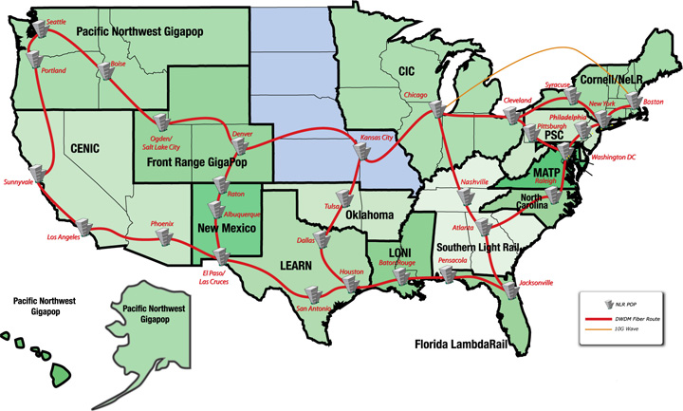
NLR Infrastructure
National Lambda Rail

Slide 21
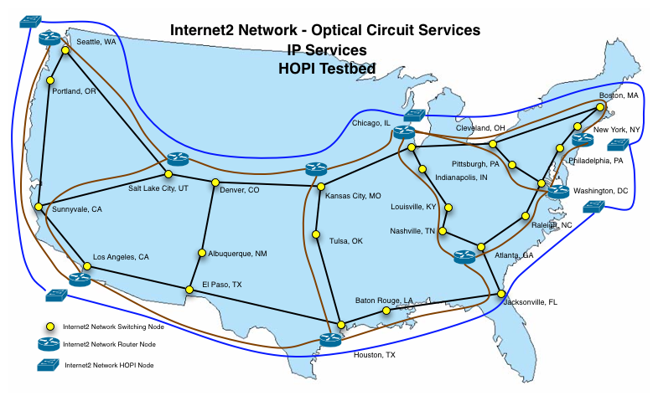
Notes:
Image Slide

Slide 22
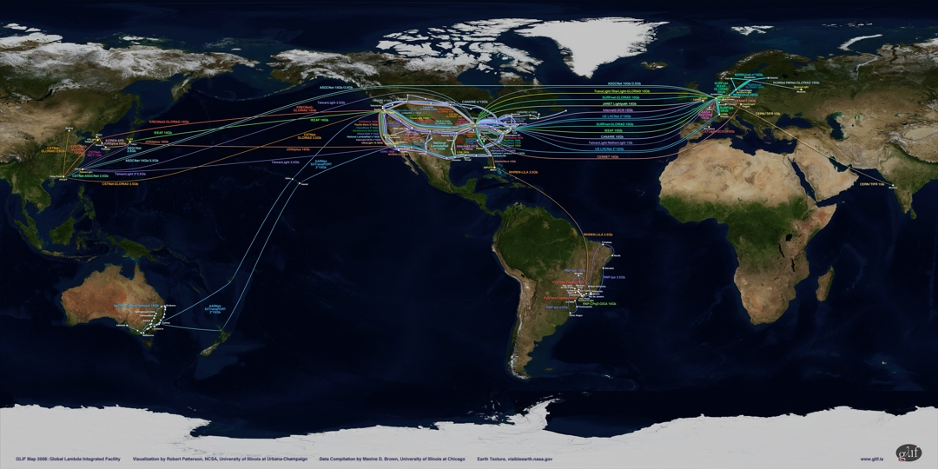
International Research & Education Network connections
The NSF IRNC program provides network connections linking U.S. research networks with peer networks in other parts of the world to support science and engineering research and education applications
Awards:
TransPAC2 (U.S. - Japan and beyond)
GLORIAD (U.S. - China, Russia, Korea)
Translight/PacificWave (U.S. - Australia)
TransLight/StarLight (U.S. - Europe)
WHREN-LILA (U.S. - Latin America)
The GLIF map shows links and networks that offer their bandwidth capacity for use by international research communities for applications-driven and computer-system experiments
http://www.glif.is

Slide 23
WHREN-LILA
5-year NSF Cooperative Agreement
Florida International University (IRNC awardee)
Corporation for Education Network Initiatives in California (CENIC)
Project support from the Academic Network of Sao Paulo (award #2003/13708-0)
CLARA, Latin America
CUDI, Mexico
RNP, Brazil
REUNA, Chile
Links Interconnecting Latin America (LILA) aims to Improve connectivity in the Americas through the establishment of new inter-regional links
Western-Hemisphere Research and Education Networks (WHREN) serves as a coordinating body whose aim is to leverage participants’ network resources to foster collaborative research and advance education throughout the Western Hemisphere

Slide 24
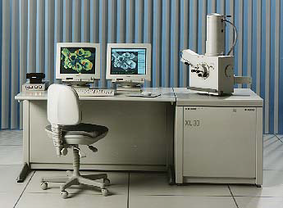
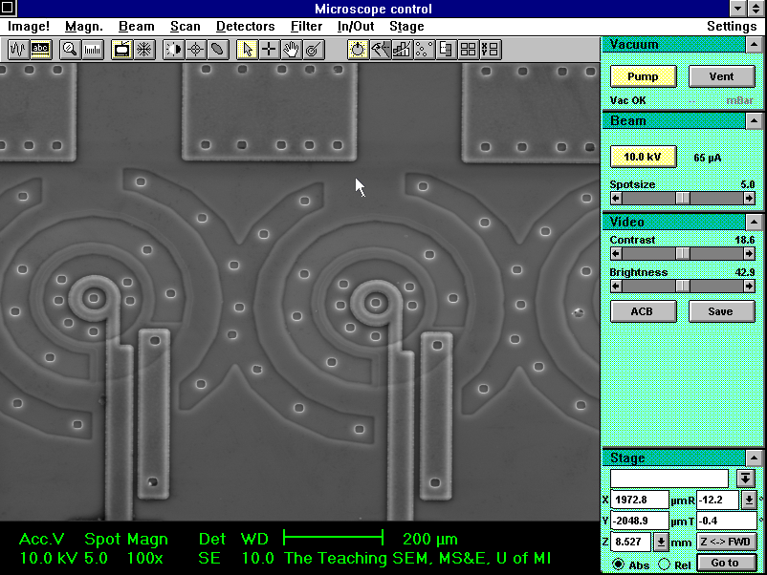
Sharing scarce educational, research resources. Access to scientific instruments for research, teaching and learning
Expensive resources can be shared between institutions, across distance
Laboratory instruments
Computers
Databases
Library materials

Slide 25
Why not the commercial Internet?
Access to the commercial Internet for education and research institutions is important
NRENs can pool demand, provide access to the commercial Internet at ‘bulk buy’ rates
Commercial Internet goal is to make money
Serve many with common-denominator capabilities
Optimize capacity for profit
NRENs who control and build their own network:
Optimize capacity (bandwidth utilization), topology (latency), services for needs of research, teaching, learning
Deploy capabilities the commercial Internet hasn’t yet deployed or isn’t interested in deploying

Slide 26
International Connectivity Pieces
US-based international exchange points
Circuits across oceans and northern, southern borders
Infrastructure within other countries, regions
Transit across partner networks

Slide 27
US-based international exchange points
Based around “coasts” of US
Typically run by members of Internet2 community
Provide fabric for interconnecting R&E networks with presence in those geographic areas
StarLight, PacificWave, MAN LAN, AMPATH, AtlanticWave

Slide 28
Operated by the Center for Internet Augmented Research and Assessment (CIARA) at Florida International University Miami, FL U.S.A
Julio Ibarra, AMPATH Principal Investigator / CIARA Exec. Director Heidi Alvarez, Director CIARA Chip Cox, AMPATH Chief Operating Officer

Slide 29
Center for Internet Augmented Research and Assessment (CIARA)
CIARA was created in 2003 as a State of Florida Type II Research Center at FIU. CIARA services institutional collaborators in the U.S. and internationally as a bridge linking researchers and educators with the infrastructure and knowledge they need to perform their work.
Notes:
29

Slide 30
AMPATH International Exchange Point
AMPATH provides Global CyberBridges fellows and faculty with connectivity to R&E computational grid resources at institutions and laboratories around the world
Connectors are U.S. and international research and education networks
Located at the NAP of the Americas in Miami
Ethernet and ATM peering fabrics
Connection types are
100 Mbps, 1 Gbps and 10Gbps Ethernet
45 Mbps, 155 Mbps and 622 Mbps ATM
155 Mbps, 622 Mbps 2.5 and 10 Gbps SDH
http://www.ampath.net for more information

Slide 31
Western Hemisphere Research and Education Network – Links Interconnecting Latin America
2.5Gbps circuit + dark fiber segment
U.S. landings in Miami and San Diego
Latin America landing in Sao Paulo, Tijuana and Miami
Interregional links improve connectivity in the Americas
Fosters collaborative research and advance education throughout the Western Hemisphere

Slide 32
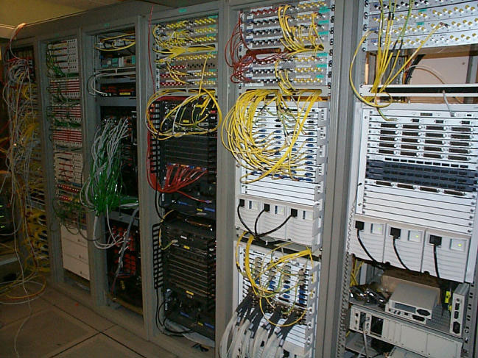
GCB Course: Grid Enablement of Scientific Applications
Dr. S. Masoud Sadjadi, Computer Science
Time of class must be coordinated with Chinese and Brazilian collaborators
May be early in the morning (7:30 – 10 am) TBD
Details on the course curriculum will be presented by Dr. Sadjadi
e-Science applications slides follow…

Slide 33
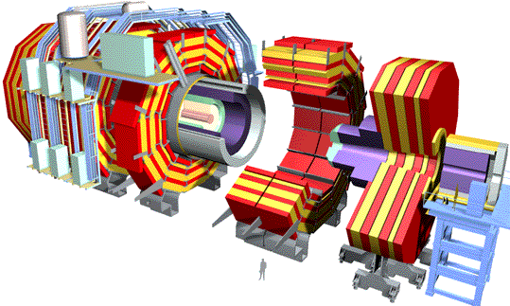
http://www.chepreo.org
An integrated program of research, network infrastructure development, and education and outreach at one of the largest minority schools in the US
Supports Brazil’s and South America’s access to Tier2s and Tier1s in the U.S. and to CERN
Collaboration with Florida State University (FSU), the University of Florida (UF), the California Institute of Technology (Caltech)
Leverages IRNC WHREN-LILA infrastructure to support data-intensive science from High-Energy Physics and Astronomy communities
Collaborations with Open Science Grid, GridUNESP, Kyatera, UltraLight and others to enable data intensive science in the western hemisphere

Slide 34
Electronic Very-Long-Baseline Interferometry (eVLBI)
Astronomers collect data about a star from many different earth based antennae and send the data to a specialized computer for analysis on a 24x7 basis.
Previously via tape and truck
Limited number of ‘campaigns’ per year
Network may fundamentally change the science
Notes:
VLBI is an example of a community that is newer to Internet2 than HENP. For the past few years, the VLBI community has been working to address a specific need– their research creates a large volume of data for a long period of time in disparate locations… and it all needs to be transferred back to one location for analysis.
To achieve this goal, the VLBI researchers have been working closely with several areas of the Internet2 community. They have learned a great deal in a short period of time. You can see this from their successful real-time tests (give example of the 100 Mbps, real-time, international correlation).
For the time being, they are learning from our community. We suspect, however, that they soon will be the experts who are helping to expand our collective knowledge and push the network.

Slide 35
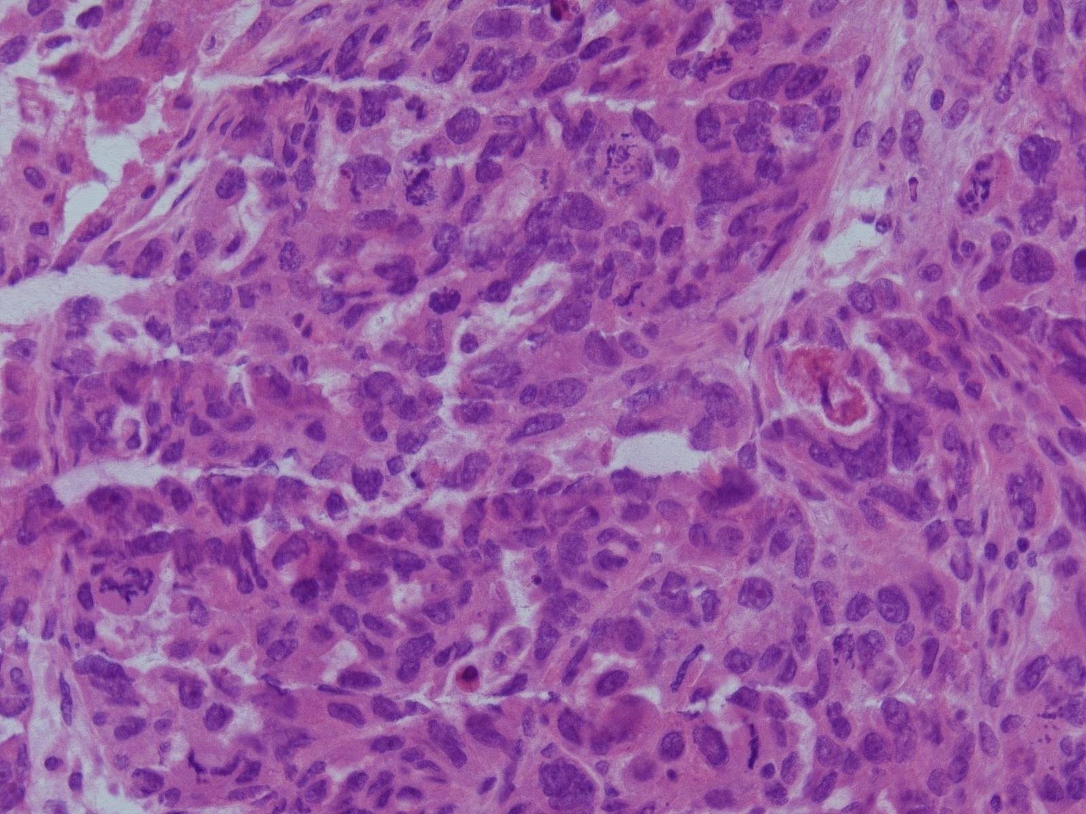
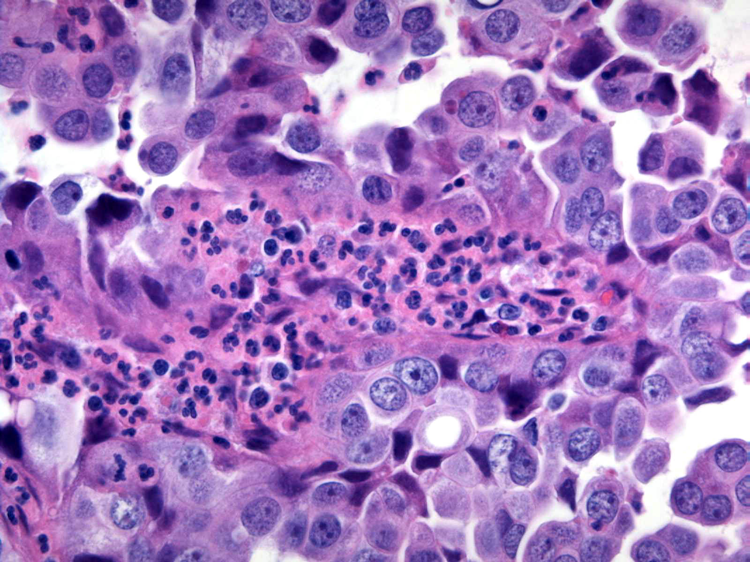
Real-time collaboration between students, teachers, researchers, clinicians
Beyond video-conferencing: pathologists share images in real-time requires high-quality images

Slide 36
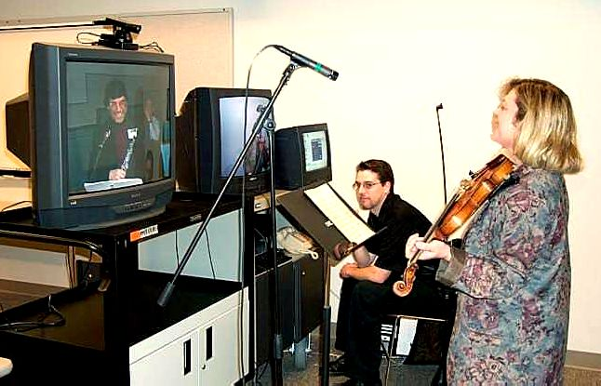
Music Master Classes
Catering to the needs of musicians
High fidelity video and audio via MPEG2
Optimized for latency, audio/video synchronization
Connecting Oklahoma with the New World Symphony in Miami, Florida
Removing physical distance as the reason why a student and instructor cannot interact
Showcases:
Distance Teaching and Learning
Video (and audio) as data
Extending the reach of resources

Slide 37
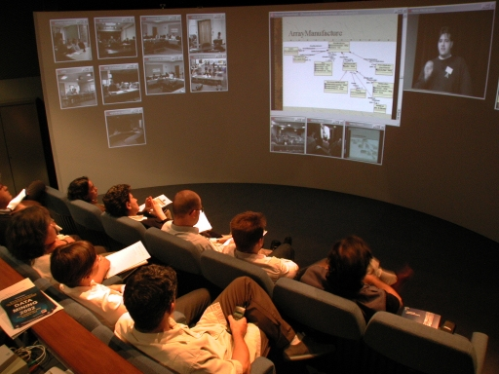
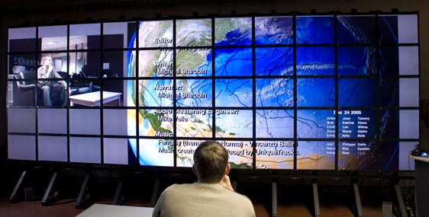
Questions?
LambdaVision 100-Megapixel display and SAGE (Scalable Adaptive Graphics Environment) software developed by the Electronic Visualization Laboratory at the University of Illinois at Chicago. Major funding provided by NSF.
Email info@cyberbridges.net
Website www.cyberbridges.net

Slide 38
Credits
WHREN-LILA, AMPATH infrastructure, CHEPREO, Global CyberBridges, science application support, education, outreach and community building efforts are made possible by funding and support from:
National Science Foundation (NSF) awards OCI-0441095, MPS-0312038, OISE-0549456, OCI-0537464, OCI 0636031, IIS 0646144, OISE 0715489, OCI 0734173, OISE 0742675
Academic Network of Sao Paulo (award #2003/13708-0)
Florida International University
Latin American Research and Education community
The many national and international collaborators

Slide 39
Heidi L. Alvarez, Ph.D. Florida International University Director, Center for Internet Augmented Research and Assessment (CIARA) heidi@fiu.edu
Thank You!
www.ciara.fiu.edu

